Slide 1

Capstone Project
The Battle of Neighborhoods
Kirtan MANKAD

Slide 2
Introduction
Background: Safety is a top concern when moving to a new area. If you do not feel safe in your own home, you are not going to be able to enjoy living there. Hence, prediction of neighborhoods before moving anywhere is a top concern area.
Problem: This project aims to predict safest borough based on crime rates, explore the neighborhoods for venue preferences and do clustering using K-Means Clustering.
Interest: Who are targeting to relocate to London will be interested to find and explore neighborhoods according to there venue preferences.

Slide 3
Data Acquisition and Cleaning
Data acquisition: Data acquired for this project is a combination of data from three sources:
The first data sources of the project is the London Crime Data that shows the crime per borough in London.
The second source of data is derived from Wikipedia page that contains list of London’s boroughs. This page also contains additional information abought these boroughs.
The third data source is the list of neighborhood in the Royal Borough of Kingston upon Thames as found on the Wikipedia page.

Slide 4
Data Cleaning: The data cleaning process for each of three data sources is done separately.
From London crime data, crimes during the most recent year are considered. The major categories of crimes are pivoted with a view to get the total crimes per boroughs for each major category.
The second data set is derived from Wikipedia page using Beautiful Soup library in python.
Two datasets are merged on the borough names to form a new data set. The purpose of this dataset s to visualize the crime rates in each borough and identify the borough where least crime recorded during the year.
After visualizing the crime in each borough we can derive the borough with lowest crime rate. The third data set is created with the names of the neighborhoods and the names of the borough with the latitude longitude obtained using Google Maps API.
The new dataset is used to generate the10 most common venues for each neighborhood using the Foresquare API. Finally used J Means Clustering algorithm to cluster similar neighborhiids together.

Slide 5
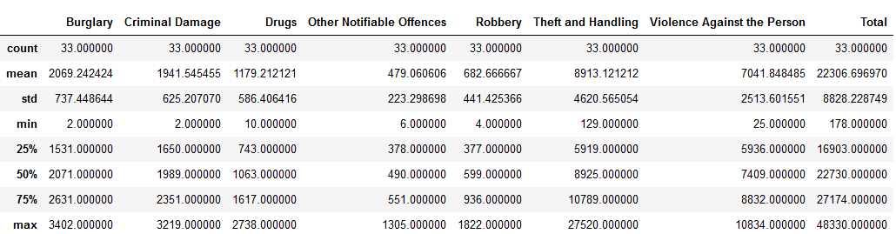
Methodology
Exploratory Data Analysis:
The count for each of the major categories of crime returns the value 33 which is the number of London boroughs. ‘Theft and Handling’ is the highest reported crime during the year 2016 followed by ‘Violence against the person’, ‘Criminal damage’. The lowest recorded crimes are ’Drugs’, ‘Robbery’ and ‘Other Notifiable offenses.

Slide 6
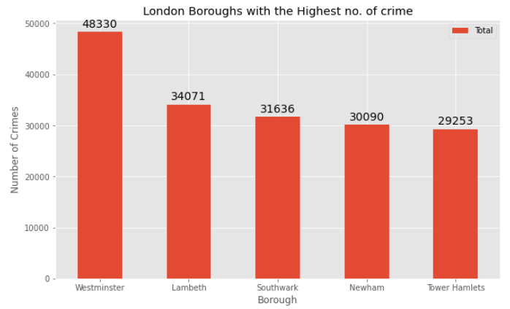
Comparing five boroughs, it is evident that Westminister has the highest crime recorded followed by Labmeth, Southwark ad Newham.

Slide 7
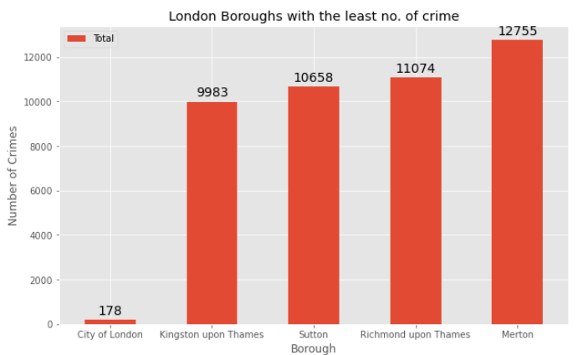
City of London has a significantly lower crime rate because it i is the 33rd principal division of Greater London but it is not a London borough. It has an area of 1.12 square miles and a population of 7000 as of 2013 which suggests that it is a small area (​see fig 3.1.3.1​). Hence, we will consider the next borough with the lowest crime rate as the safest borough in London which is Kingston upon Thames.

Slide 8
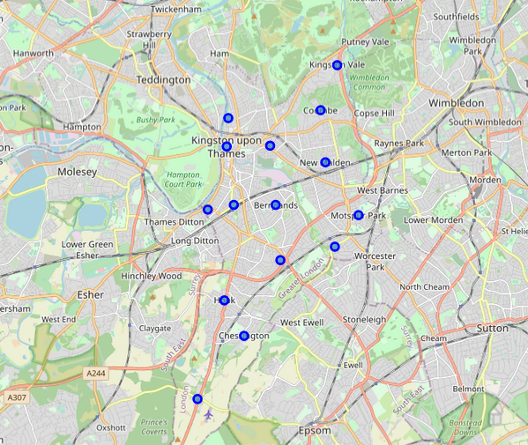
There are 15 neighborhoods in the royal borough of Kingston upon Thames, they are visualized on map using folium library in python.

Slide 9
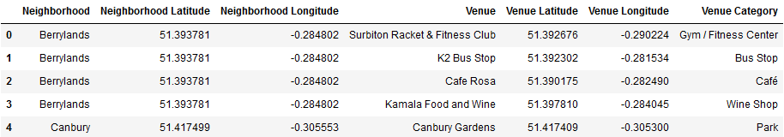
Modelling
Using the final dataset containing the neighborhoods in Kingston upon Thames along with the latitude and longitude, we can find all the venues within a 500 meter radius of each neighborhood by connecting to Foursquare API.
To help people find similar neighborhoods, we will be clustering similar neighborhoods using K-means clustering which is the form of unsupervised machince learning.
I have used the cluster size of 5. Reason of using K-means clustering is to cluster neighborhoods with similar venues.

Slide 10
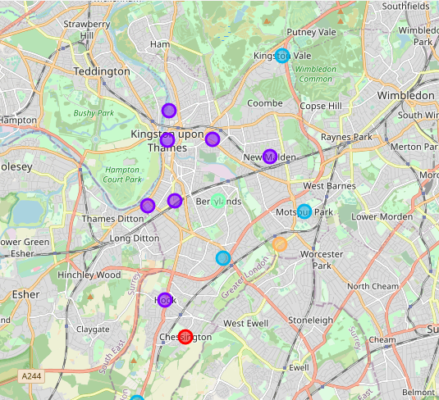
Result
After performing K-means clustering, we can access each cluster created to see which neighorhoods were assigned to each of the five clusters. I have used folium to visualize clustered neighborhood on map.

Slide 11
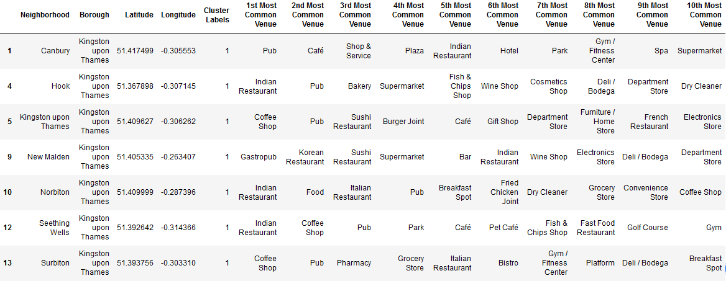
Cluster 1:
Cluster 2:

Slide 12
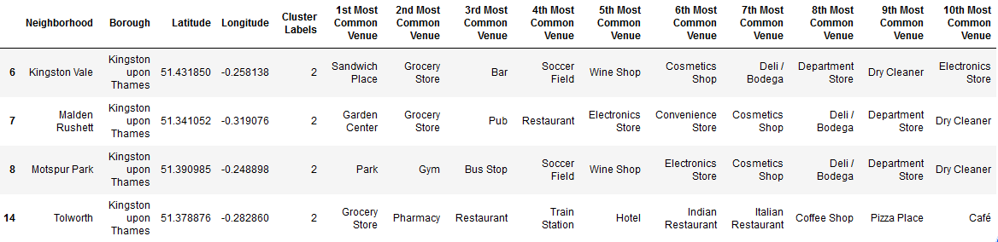
Cluster 3:
Cluster 4:
Cluster 5:

Slide 13
Discussion:
The aim of this project is to help people who want to relocate to the safest borough in London, expats can choose the neighborhoods to which they want to relocate based on the most common venues in it.
For example, if a person is looking for a neighborhood with good connectivity and public transportation we can see that Clusters 4 and 5 have Train stations and Bus stops as the most common venues.
If a person is looking for a neighborhood with stores and restaurants in a proximity, then the neighborhoods in the second cluster is suitable.
For a family I feel that the neighborhoods in Cluster 3 is more suitable due to the common venues in that cluster, these neighborhoods have common venues such as Parks, Gym/Fitness centers, Bus Stops, Restaurants, Electronics Stores and Soccer fields which is ideal for a family.

Slide 14
Conclusion
This project helps a person get a better understanding of the neighborhoods with respect to the most common venues in that neighborhood.
It is always helpful to make use of technology to stay one step ahead i.e. finding out more about places before moving into a neighborhood.
We have just taken safety as a primary concern to shortlist the safest borough of London.
The future of this project includes taking other factors such as cost of living in the areas into consideration to shortlist the borough, such as filtering areas based on a predefined budget.

